Slide 2
About : who we are & what we do

Slide 3
ABOUT
Valuable insights & stories anchored in real life
Immersive and ethnographic approach of consumer research
Co-creation, step-by-step
Use of new technologies & research methods
Relevant emotional unmet needs
(articulated or unarticulated)
Meaningful moments

Slide 4
Innovation, Online Qual
& International Market Research
From cultural / ethnographic / digital insights …
to branding, storytelling and innovation workshops.
Online communities – International coverage (Europe, Asia, USA, Australia)

Slide 5
VISION & VALUES
The world never stops evolving
Tomorrow starts today. Let’s create the stories for tomorrow now. Let’s innovate together. Because through collaboration and co-creation we can more easily light amazing sparkles. Let’s connect the power of our brains so we can create blooming brands.
Nowadays ideas and people travel worldwide. Thinking local is good. But always considering an international frame.
Digital tools can be very resourceful and help us save time and be more efficient. Meetings are great but they are not always necessary. Let’s be more agile, flexible and connected.
Everyone can be creative. Let’s use the design thinking approach and act more as curious explorers, let our thoughts cross some boundaries and wander in uncharted territories for a few moments. Thus, we can find great inspiration and uncover strong and meaningful insights in consumers lives.
Flexibility, open mindedness and personalization are key in this constantly evolving world. Rigidity and standardization are old-fashioned. Don’t be afraid to recalibrate your projects and ideas. Changes may bring positive results and success.

Slide 6
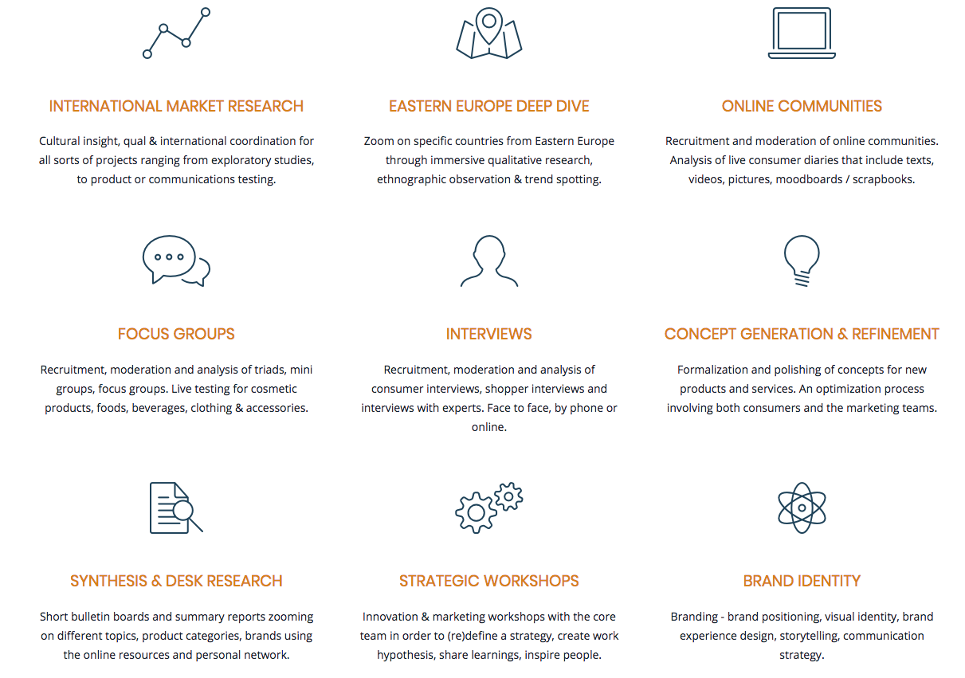
SERVICES (OFFER OVERVIEW)

Slide 7
BUSINESS APPROACH
> A network approach
We work with senior reliable partners and experts worldwide
and can be hired as a project leader
or as a member of a wider global team
to deliver operational and qualitative results.

Slide 8
PROJECTS
Brand audit & image perception - Focus groups, online community (France)
Concept test & optimization - Focus groups (USA, France)
Portraying of relevant tribes - Innovation workshop (France)
Branding & brand platform test - Digital pre-task + Focus groups (France, UK, USA, China)
Concept test & innovation - Co-creative online community (France)
Product feature assessment - Focus groups (USA, China)
Trends & Innovative services - Desk research, expert interviews, synthesis
Website look & feel, ergonomics and content strategy - image research, consultancy in ergonomics and navigation, content supervision (France)

Slide 9
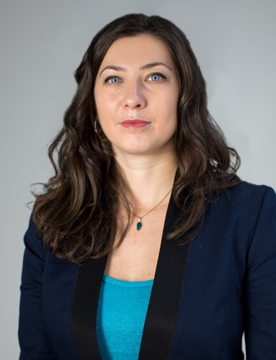
FOUNDER & CEO
Andreea Jacob
9 years experience in innovation, strategic marketing and cultural insights at an international scale.
Main fields of expertise: food & beverage, fragrance & cosmetics, luxury, hotel industry, car rental, services, new technologies.
Specialization in qualitative research and online communities.

Slide 10
INTERNATIONAL ONLINE MARKET RESEARCH
A/ Why online Qual research

Slide 11
A/ WHY ONLINE QUAL RESEARCH
ONLINE COMMUNITIES
= ONE METHODOLOGICAL PILLAR THAT ENRICHES THE STRATEGIC / CREATIVE THINKING
Validation / optimisation focus groups
Online communities
Strategic workshop
Strategic workshop
Online communities
Validation online communities
Optimization workshop
Inspiration online communities
Strategic workshop
Validation / optimisation focus groups
Co-creation online communities
Enriching online communities
Quant test / Need states exploration
Inspiration online communities

Slide 12
A/ WHY ONLINE QUAL RESEARCH
5 main benefits
Content richness
Iterative “test & learn” approach with longer deeper interactions
Immersive, personal
… and yet less intrusive approach
Convenience & less geographical constraints
Client friendliness

Slide 13
INTERNATIONAL ONLINE MARKET RESEARCH
B/ When opt for online Qual & digital communities

Slide 14
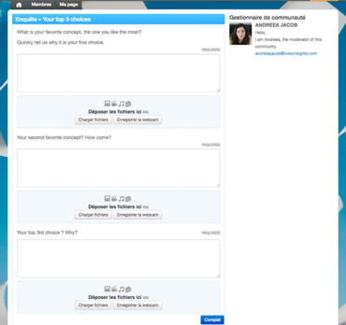
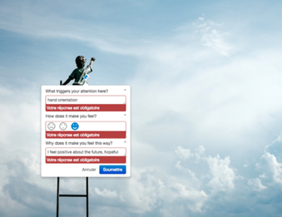
B/ WHEN OPT FOR ONLINE QUAL & DIGITAL COMMUNITIES
ONLINE COMMUNITIES & USE OF DIGITAL TOOLS are appropriate for:
co-creation with consumers
inspiration and understanding of specific / sensitive topics
assessing emotions, reactions and points of interest during a customer journey
internal innovation & evaluation / concept validation procedures saving an incredible amount of “meetings time”
Vote & identification of winning concepts
Evaluation of strong / key elements & features

Slide 15
B/ WHEN OPT FOR ONLINE QUAL & DIGITAL COMMUNITIES
… At almost any step of the strategic / innovation process
PERCEPTION / DEEP UNDERSTANDING / CONCEPTUALIZATION
Brand image perception & audience understanding
Concept creation and/or formalization
EVALUATION / TEST
Concept assessment & ranking
IMPROVEMENT / CURATION
Concept optimisation
GO / NO GO
Concept validation

Slide 16
Eastern Europe Deep Dive

Slide 17
EASTERN EUROPE DEEP DIVE
A region with a high business potential
80 million potential consumers across all countries in the post-communist eastern block (excluding Ukraine & Russia)
Strong need to be in line with the rest of the world and get social validation in most of the Central & eastern European countries
People who have and spend more money in recent years
Open to international brands
Consumers look for new experiences …even if pragmatism and smart shopping are still major trends for most people
Recently, rise of local commerce and brands
English spoken by Millennials and young adults in urban areas
High Internet use
Geographical proximity with Western Europe
Easy access by plane to city capitals (rather well-developed)
POLAND
CZECH
REPUBLIC
SLOVAKIA
HUNGARY
ROMANIA
BULGARIA

Slide 18
About the facility: the Lively Place

Slide 19
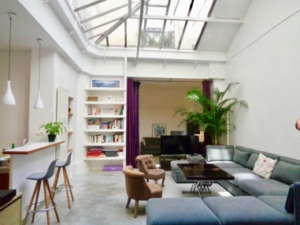
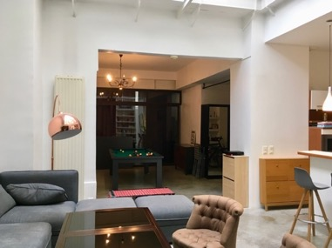
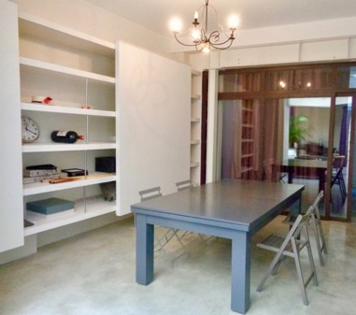
RENTAL OF THE « LIVELY PLACE » - The insightment / workshop area (+ independent atelier if needed)
DESCRIPTION
2 to 4 different spaces that can be used separately or as a whole, glass roof, TV, couch, 3 big tables, chairs, American pool table
70 m²
Suitable for running morning breakfasts, strategic reunions, creative workshops, brainstorming sessions, innovation workshops / groups
Guests : ideally 10 to 15 people (max 20)
BAR
*Access to the independent atelier when required (extra-cost)
Confidential information

